Slide 1
DATASOFTIXS INTERSHIP PROJECT SUMMARY (WEEKS 1-3)
WEB DEVELOPMENT
INTERN ID:WD100024
Presented by: W.KARISHMA
Mohamed Sathak A.J College Of Engineering
Date:1st Jan 2025 -1st Feb 2025

Slide 2
SOCIAL LINKS
LINKEDIN:
https://www.linkedin.com/in/karishma1310/
GITHUB:
https://github.com/KarishmaWajid
HOSTED LINK:
https://karishma-digitalportfolio-60035978658.development.catalystserverless.in/app/index.html
https://ramadan-todolist-planner-60035978658.development.catalystserverless.in/app/index.html

Slide 3

WEEK(1-3) PROJECT PROJECT NAMES
DIGITAL PORTFOLIO
RAMADAN TODO LIST
SKYWATCHER’S COMPANION

Slide 4
WEEK -1
“MY DIGITAL PROTFOLIO”
DESCRIPTION:
The project titled "My Digital Portfolio" is a responsive website designed to present my personal skills, achievements, and projects in an organized and visually appealing manner. The portfolio consists of four key sections:
KEY SECTION:
ABOUT ME: This section introduces my background, interests, and professional aspirations, providing a concise overview of who I am.
PROJECTS: A detailed showcase of my completed projects, highlighting my technical expertise and creative problem-solving abilities.
SKILLS: A display of my technical and soft skills, categorized for easy navigation.
CONTACT:A section where visitors can reach me through a contact form or social media links.

Slide 5
CODE
TOOLS: Visual Studio Code
TECHNOLIOGIES USED: HTML and CSS
<!DOCTYPE html>
<html lang="en">
<head>
<meta charset="UTF-8">
<meta name="viewport“ content="width=device-width, initial-scale=1.0ca">
<title>My Digital Portfolio</title>
<link rel="stylesheet“ href="front_page.css">
</head>
<body>
<div class="hero">
<h2>Welcome to My Digital Portfolio</h2>
<p>A showcase of my skills, projects, and achievements.</p>
<div class="button-container">
<a href="about_page.html" class="btn">Explore</a>
<a href="Karishma_Resume.jpg" class="btn“ target="_blank">Resume</a>
</div>
</div>
</body>
</html>

Slide 6
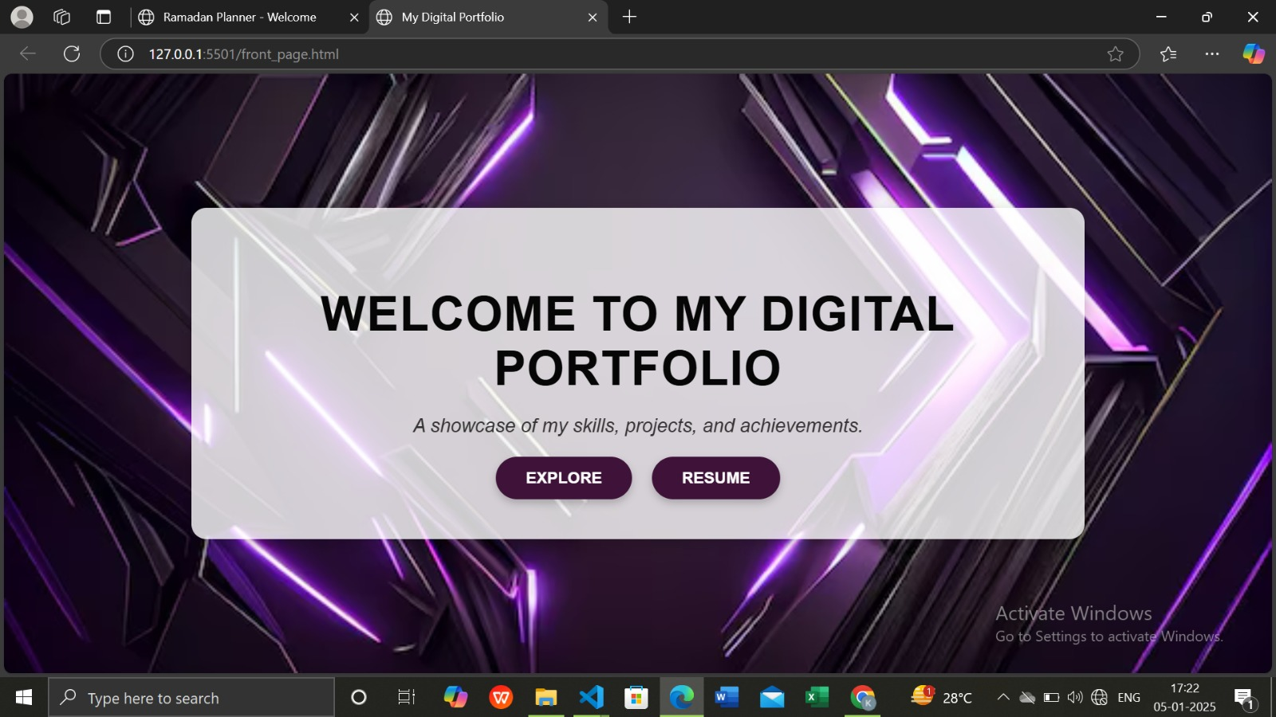
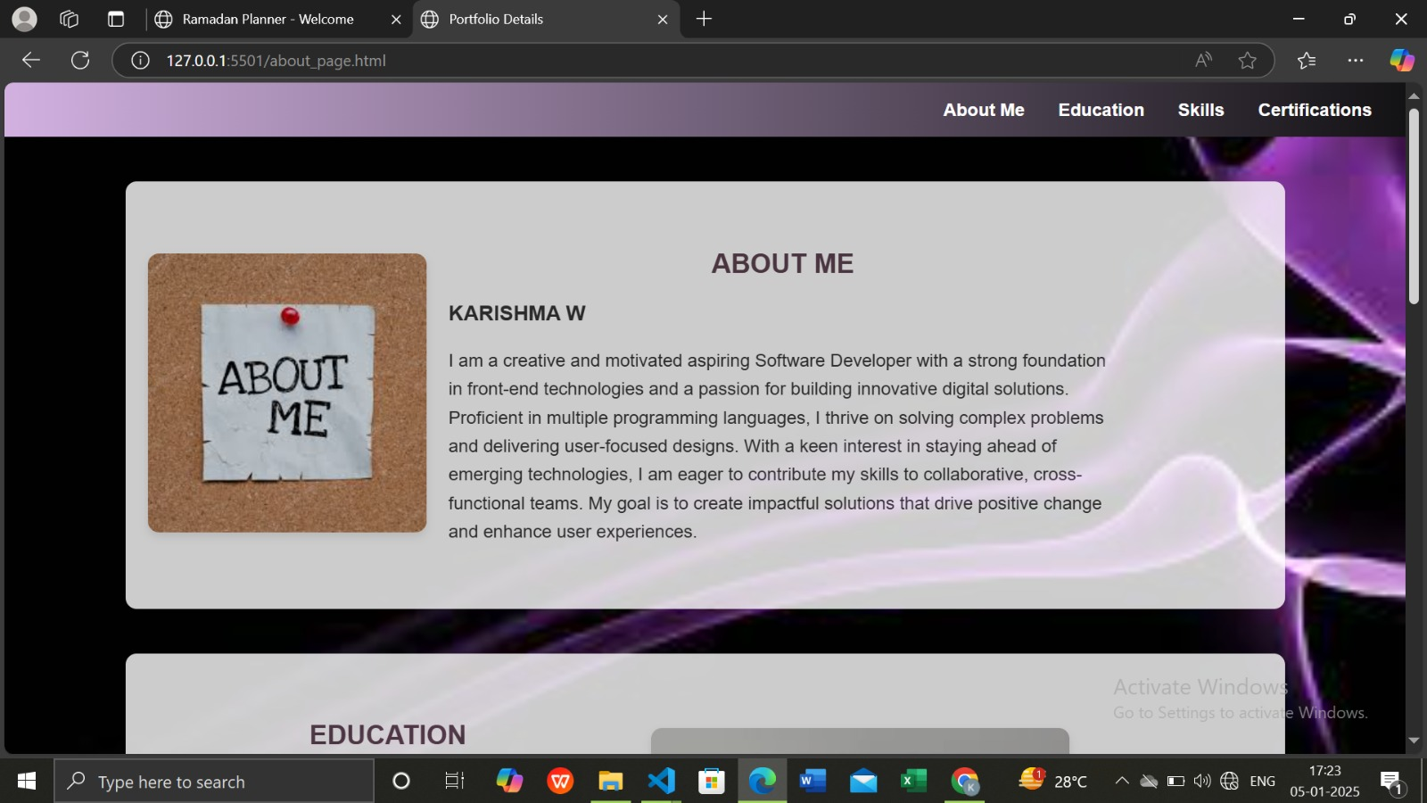
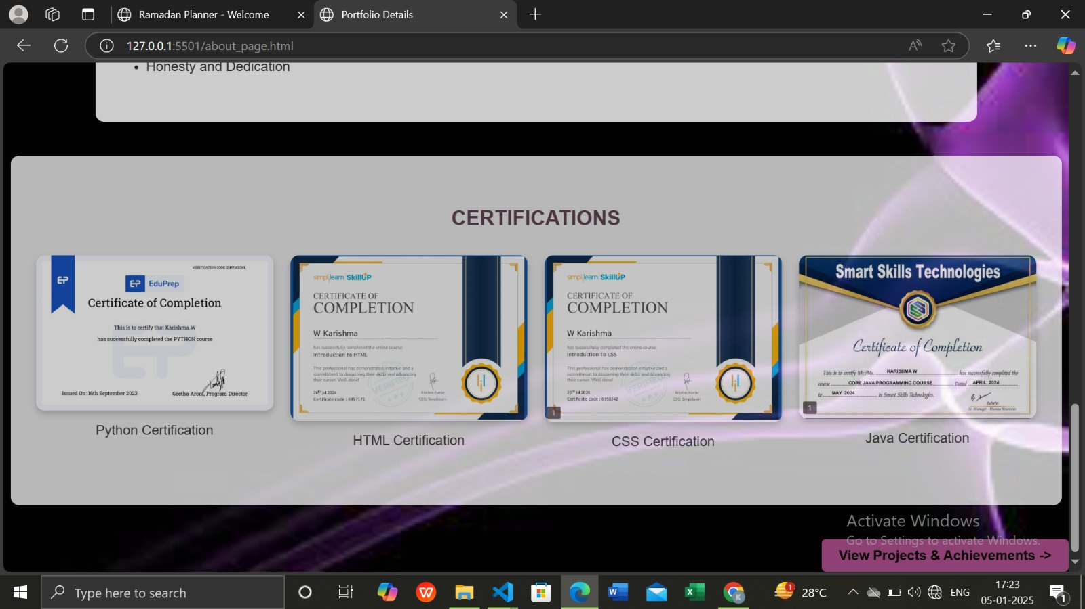

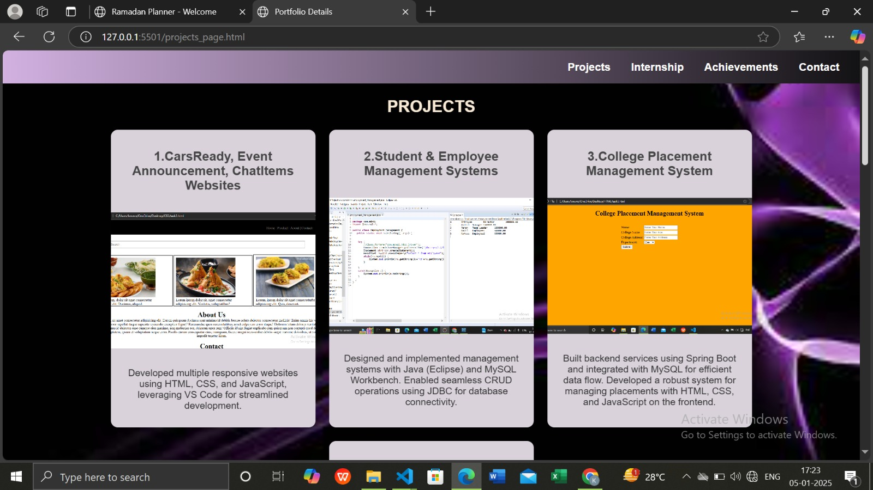
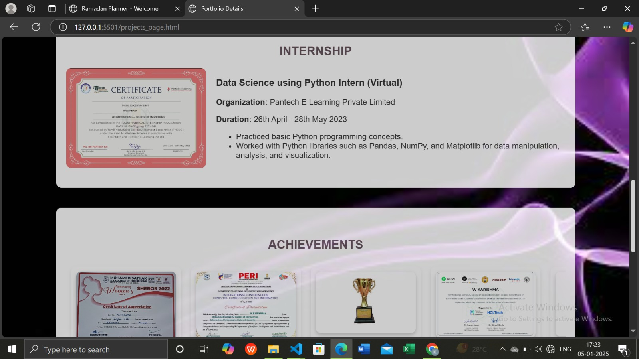

Slide 7
Week-2 ramadan to-do list
DESCRIPTION:
The Task Master project focuses on developing an interactive and functional to-do list application that enhances task management for users. The application allows users to add new tasks, mark them as complete, and delete them, ensuring seamless interaction. By leveraging JavaScript, tasks are stored in local storage, providing persistence even after closing the application. Styled with CSS, the application delivers an engaging and user-friendly interface. An optional drag-and-drop feature can be incorporated to enable intuitive task reordering, making the experience more dynamic and interactive. This project combines functionality and design to create a practical tool for everyday productivity.

Slide 8
CODE
TOOLS: Visual Studio Code
TECHNOLIOGIES USED: HTML , CSS AND JAVASCRIPT
tasks.forEach((task, index) => {
const li =
document.createElement("li");
const taskText =document.createElement("span");
taskText.innerText = ${task.text} ${task.time};
if (task.completed) taskText.classList.add("done");
const completeButton =
document.createElement("button");
completeButton.innerText = "✔";
completeButton.onclick = () => {
tasks[index].completed = !
tasks[index].completed;
tasks[index].completed;
localStorage.setItem("ramadanTasks",
JSON.stringify(tasks));
renderTasks();
};
const deleteButton =
document.createElement("button");
deleteButton.innerText = "🗑";
deleteButton.onclick = () => {
tasks.splice(index, 1);
localStorage.setIt
em("ramadanTasks",
JSON.stringify(tasks));
renderTasks();
};
li.appendChild(taskText);
li.appendChild(completeButton);
li.appendChild(deleteButton);
taskContainer.appendChild(li);
}

Slide 9
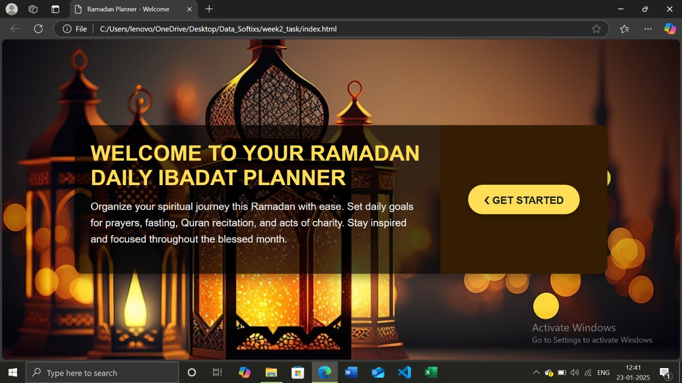
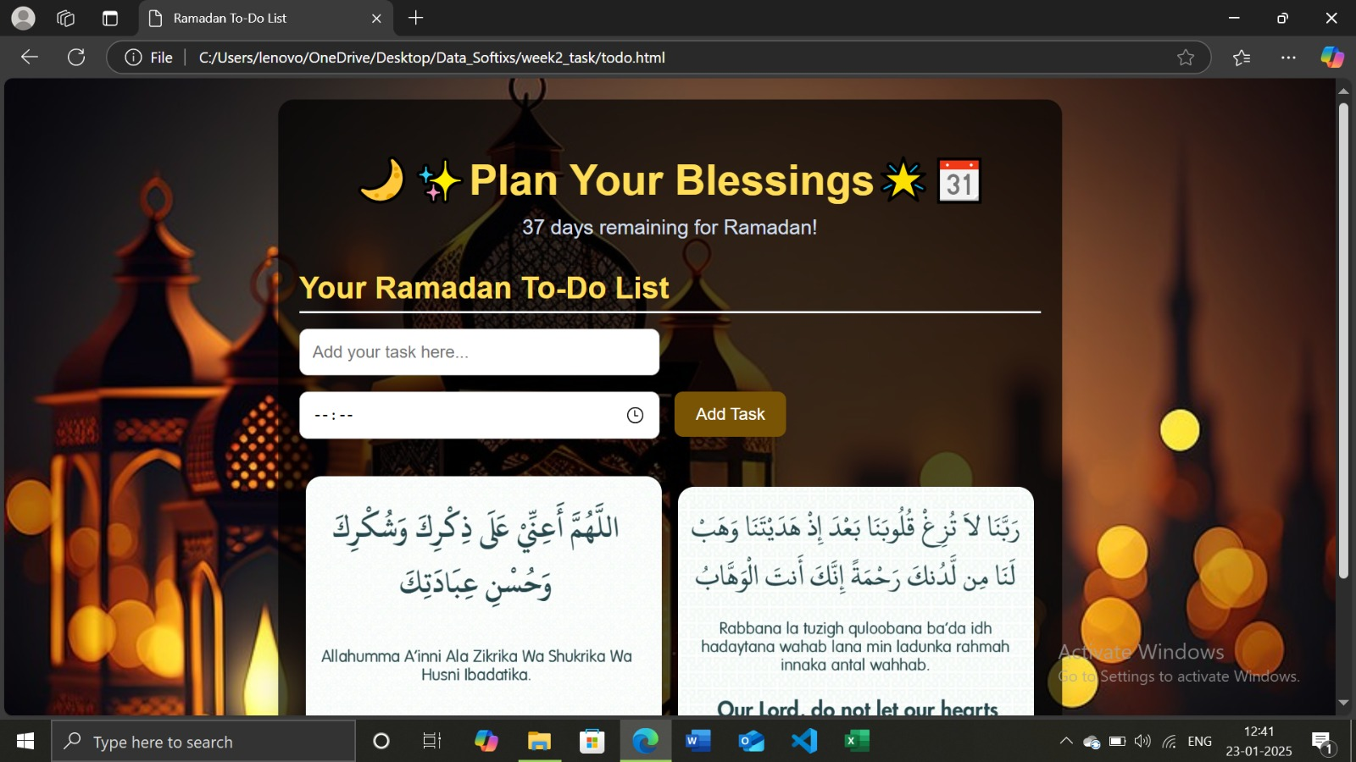
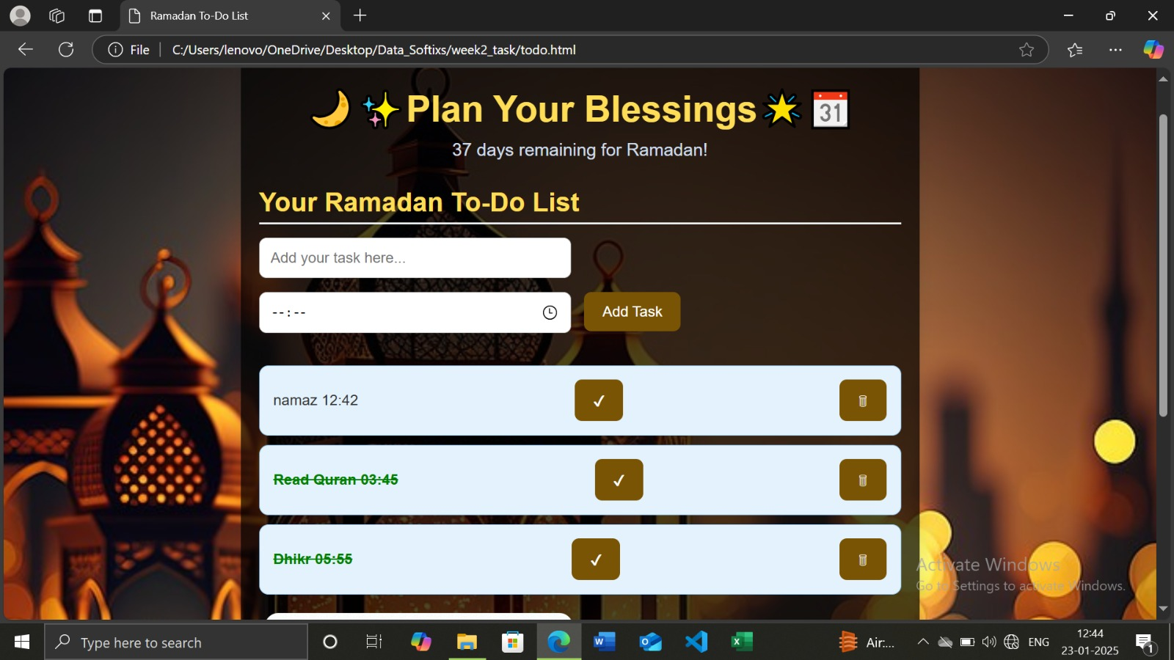
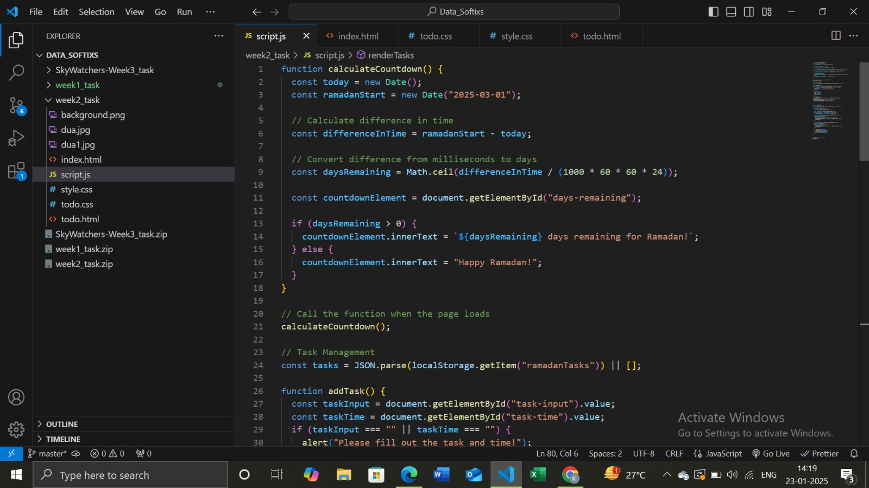

Slide 10
WEEK-3 SKYWATCHER’S COMPANION
DESCRIPTION:
The Skywatcher's Companion project is a weather dashboard designed to provide real-time weather updates in a user-friendly and visually appealing format. By utilizing a weather API, the application fetches and displays key weather details such as temperature, humidity, and conditions for any searched city. A search bar enables users to quickly look up weather information for their desired locations. Styled with CSS, the dashboard delivers an engaging design, with an optional feature to dynamically change the background based on the current weather (e.g., sunny or rainy), enhancing the interactive experience. This project combines functionality with aesthetic appeal to create an essential tool for weather enthusiasts.

Slide 11
CODE
TOOLS: Visual Studio Code
TECHNOLIOGIES USED: React.js for frontend, MySQL for Database Management, Node.js for backend
import React, { useState, useEffect }
from 'react’;
import SearchBar from ‘./
components/SearchBar’;
import WeatherDisplay from ‘./
components/WeatherDisplay’;
import './App.css’;
const App = () => {
const [weather, setWeather] =
useState(null);
const [background, setBackground]
= useState('default');
useEffect(() => {
if (weather) {
const condition = weather.weathe
r[0].main.toLowerCase();
if (condition.includes('clear')) { setBackground('sunny');
} else if (condition.includes('rain’))
{
setBackground('rainy');
} else if
(condition.includes('cloud')) { setBackground('cloudy');
} else {
setBackground('default');
}
}
}, [weather]);
useEffect(() => {
document.body.className =
background;
}, [background]);
return (
<divclassName="container> <h1>Skywatcher'sCompanion</
h1>
<SearchBar setWeather={setWeather} /> <WeatherDisplay weather={weather} />
{!weather && (
<p className="description"> Welcome to Skywatcher's Companion! This app helps you stay updated with real-time weather conditions for any city.
Simply enter the name of your city in the search bar above to explore the weather forecast.
Stay informed and plan your day better with Skywatcher's Companion!
</p>
)}
</div>
);
};
export default App;

Slide 12
WEATHER_API_KEY=d7cb042941c78b0f21ec6cb54b54e812
const express=require('express’);
const cors = require('cors’);
const mysql=require('mysql’);
const dotenv=require('dotenv’);
const axios = require('axios’);
dotenv.config();
const app = express();
app.use(cors());
app.use(express.json());
const db = mysql.createConnection({ host: process.env.DB_HOST,
user: process.env.DB_USER,
password:
process.env.DB_PASSWORD,
database: process.env.DB_NAME,
});
db.connect((err) => {
if (err) throw err; console.log('Connected to MySQL database’);
});
app.post('/search', (req, res) => { const { city } = req.body;
const API_KEY = process.env.WEATHER_API_KEY;
axios
.get(https://
api.openweathermap.org/
data/2.5/weather?q=$
{city}&appid=${API_KEY}
&units=metric)
.then((response) => {
const weatherData = response.data;
// Save search to the database
const sql = 'INSERT INTO
searches (city) VALUES (?)'; db.query(sql, [city], (err) => {
if (err) throw err;
});
res.json(weatherData);
})
.catch((error) => { console.error(error); res.status(500).send('Error
fetching weather data’);
});
});
app.listen(5000, () => { console.log('Server running on http://localhost:5000’);
});

Slide 13
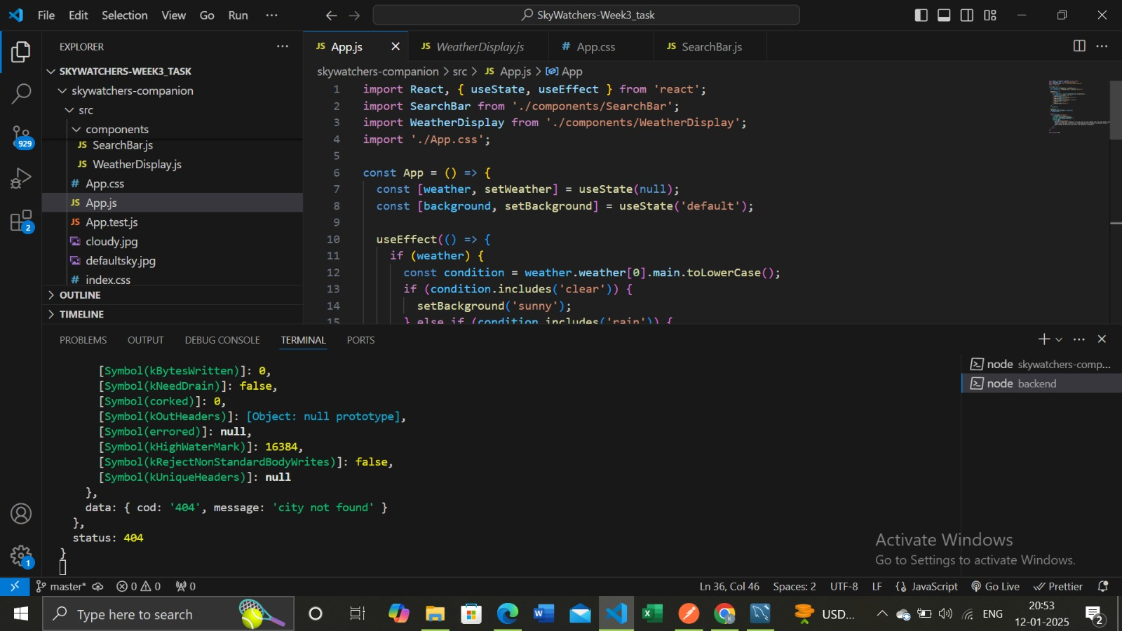
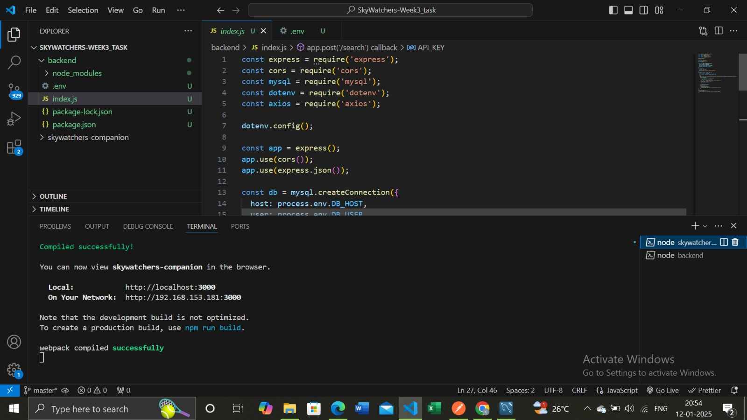
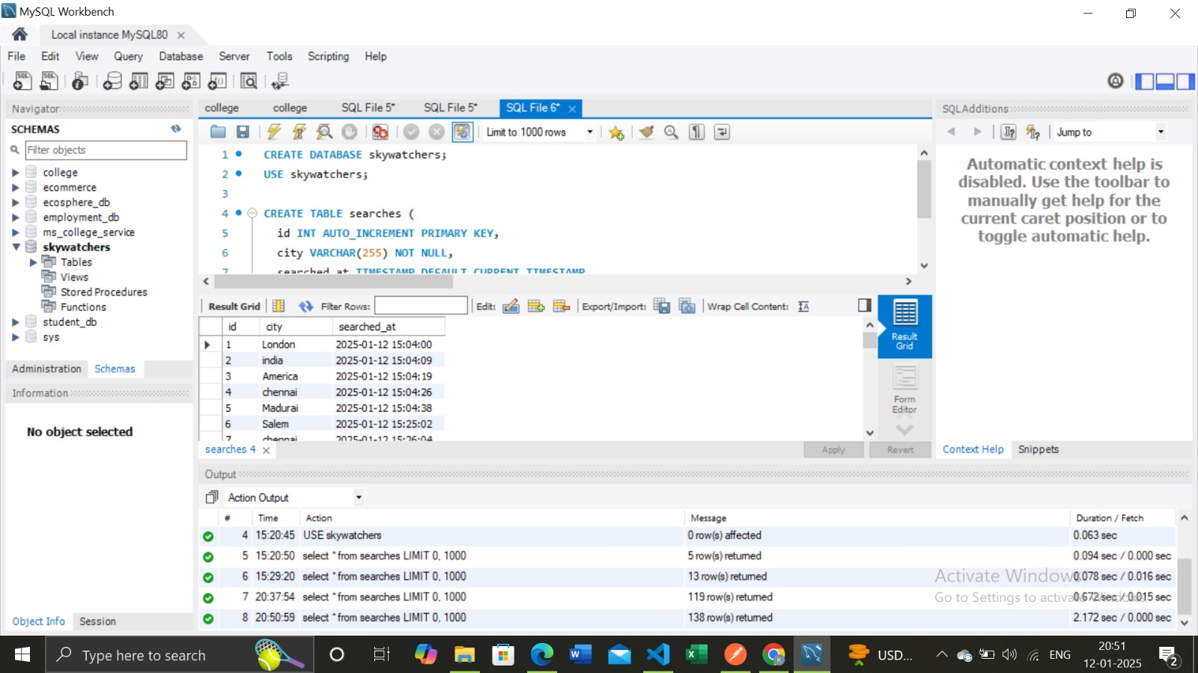

Slide 14
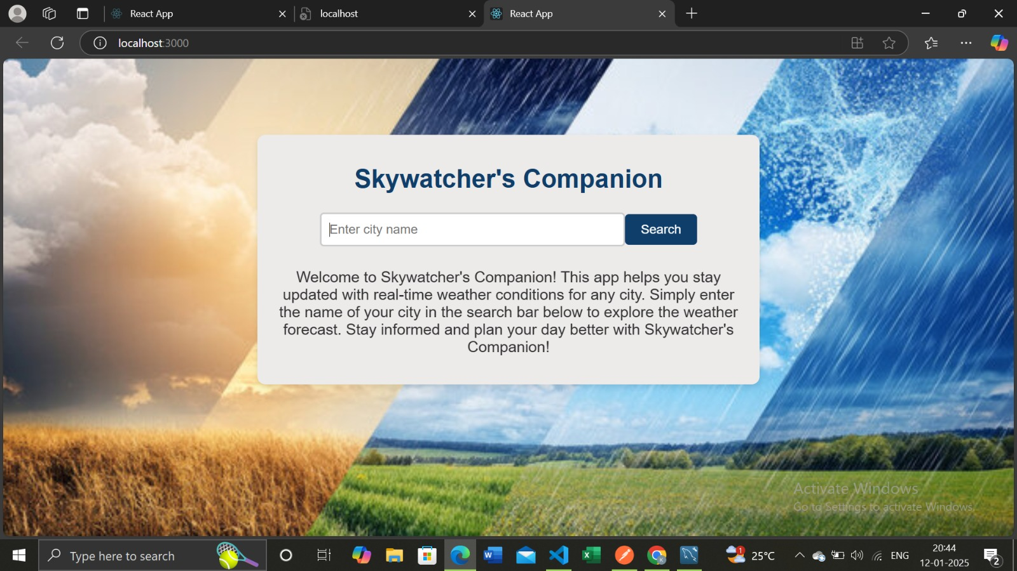
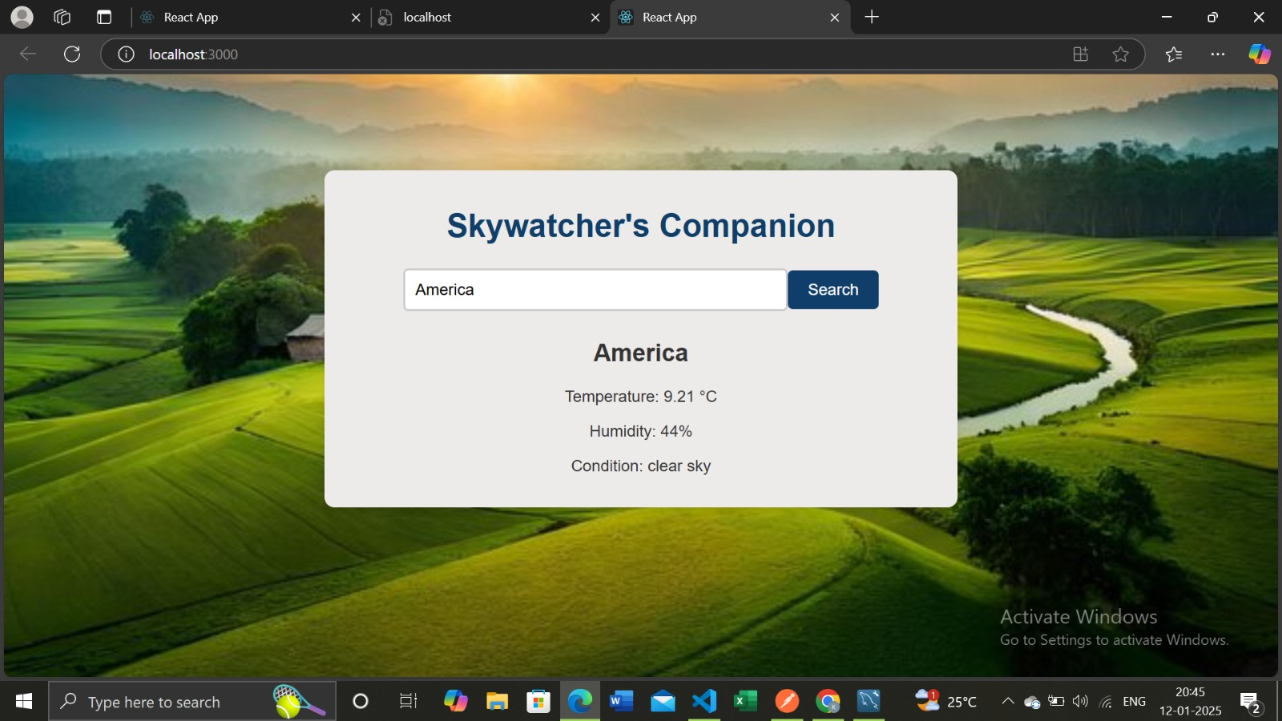
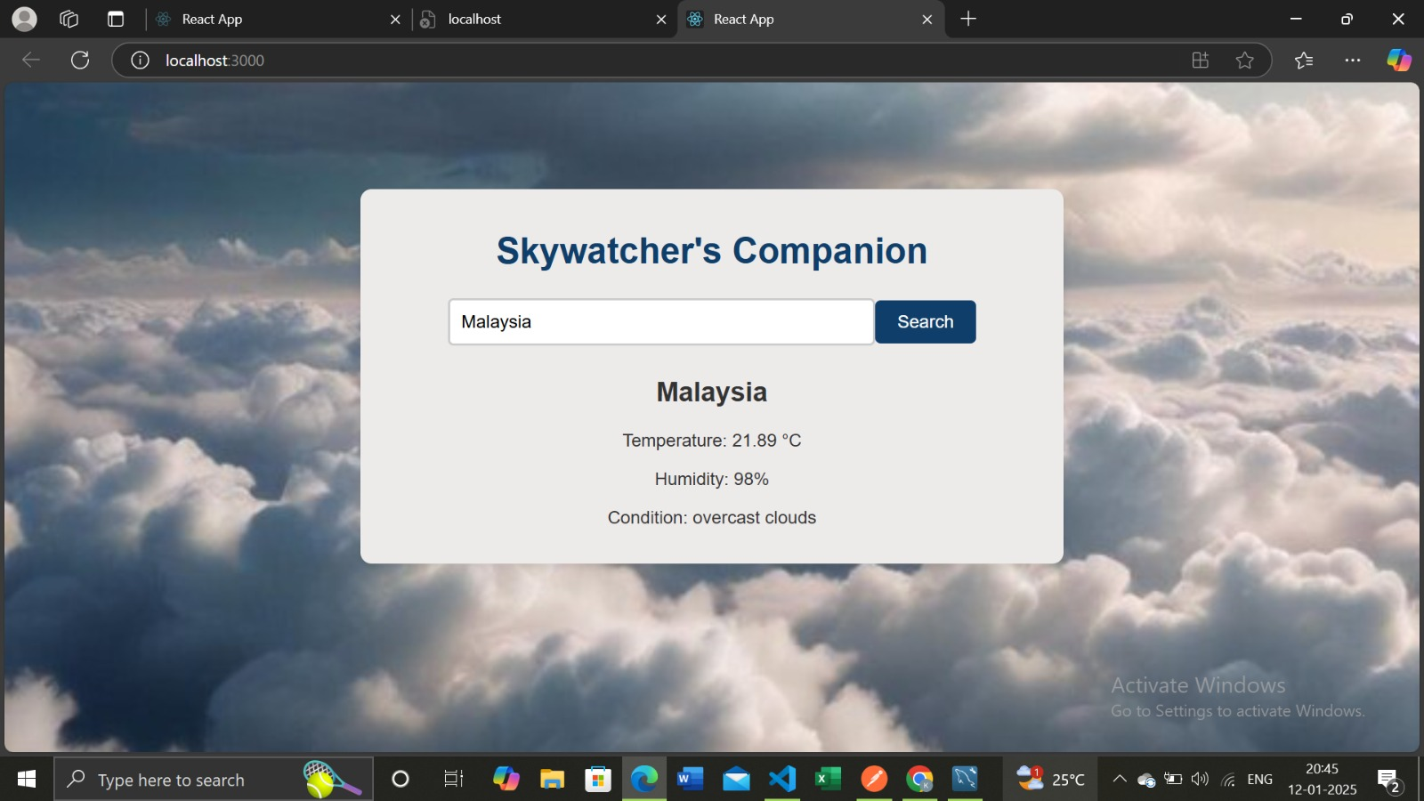
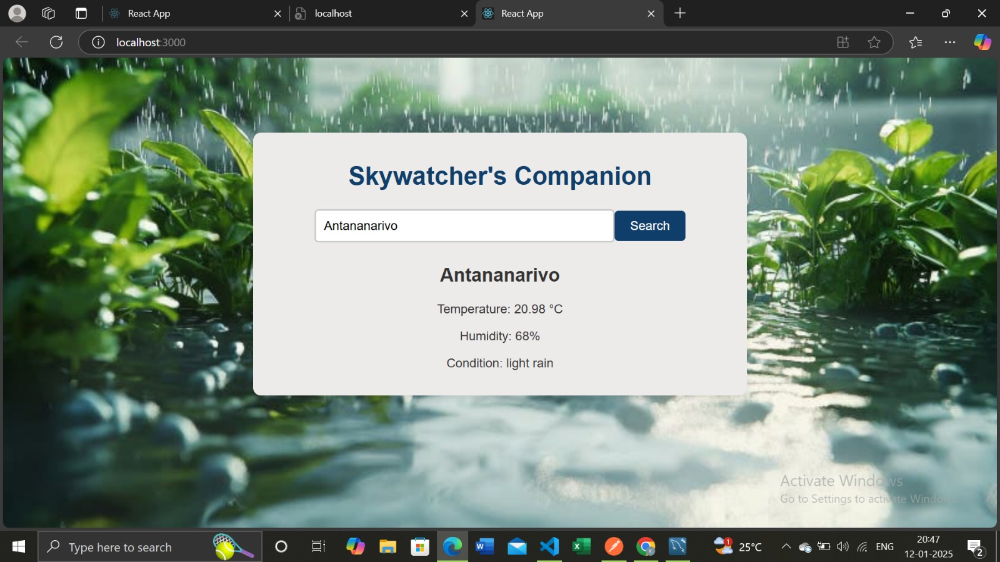

Slide 15
THANK YOU

